Slide 1

Getting started with Image data
Dr. Gunjan Joshi
2025-10-28

Slide 2
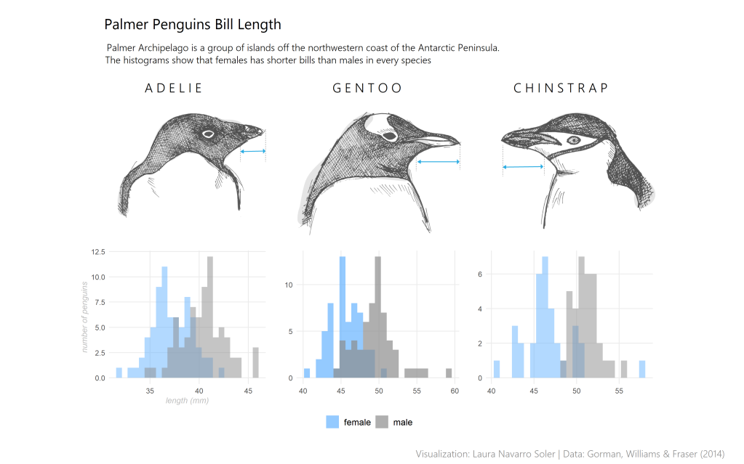
Tabular data
https://lauranavarroviz.wordpress.com/2020/08/01/palmer-penguins/

Slide 3
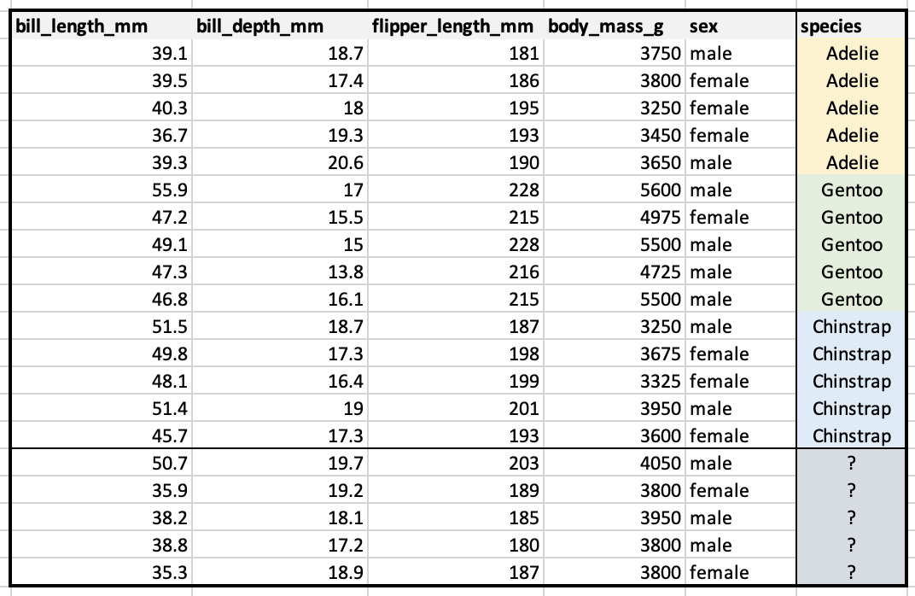
Tabular data
Rows and columns (structured data)
→ Easy to visualize and interpret (few features per sample)
https://campus.datacamp.com/courses/understanding-artificial-intelligence/tasks-ai-can-solve?ex=8

Slide 4
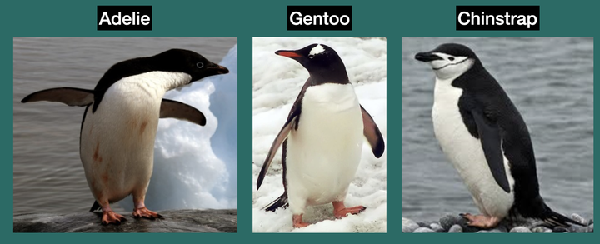
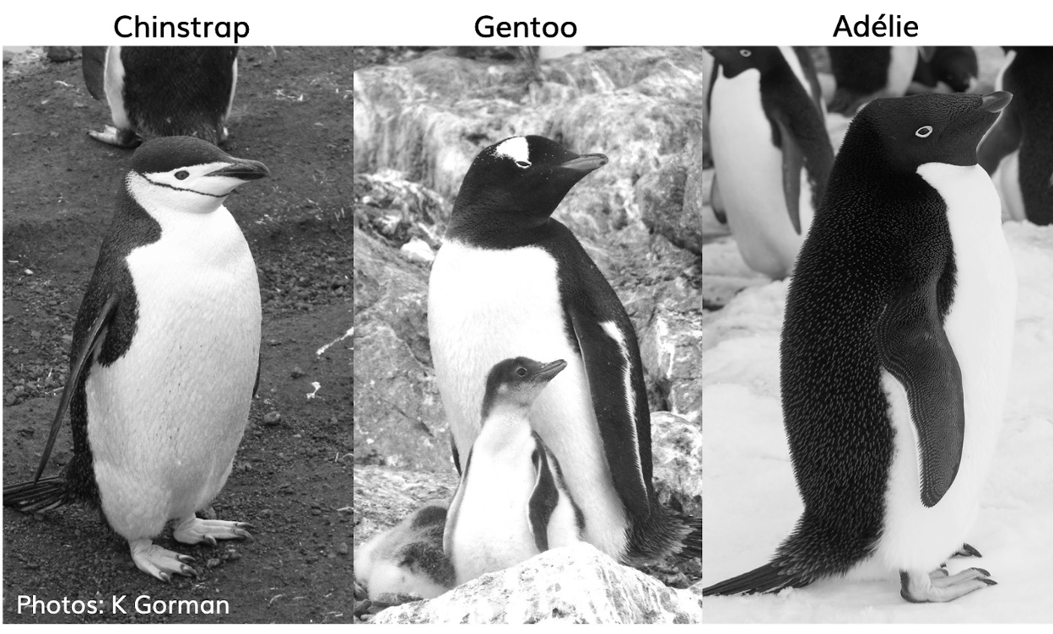
Image data
Images are grids of pixels (unstructured data)
Each image has thousands of “features” (pixels × color channels)
Spatial relationships between pixels carry meaning
We use Convolutional Neural Networks (CNNs) to detect edges, shapes, textures
Goal remains the same → predict a label
https://education.rstudio.com/blog/2020/07/palmerpenguins-cran/
https://www.gabemednick.com/post/penguin/

Slide 5
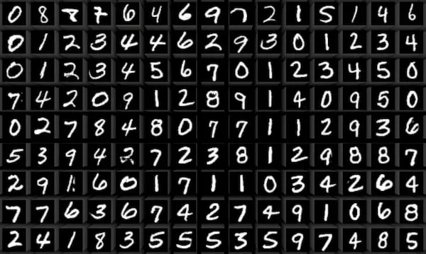
Image data
MNIST
What it is: Handwritten digits 0–9.
Size: 70,000 grayscale images, each 28 × 28 pixels. 60,000 for training, 10,000 for testing. Kaggle+1
Task: “Which digit is this?”
Why we like it: Super easy classification. You can get >99 percent accuracy with a tiny CNN.
Limitation: It’s too clean and too easy, not very “real world.”
https://datasets.activeloop.ai/docs/ml/datasets/mnist/

Slide 6
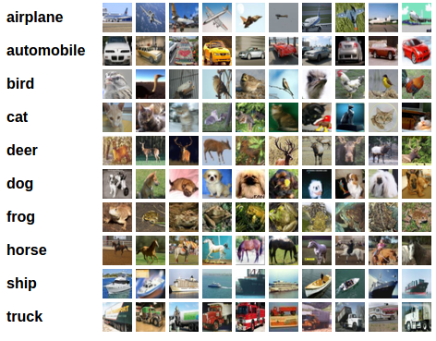
Image data
CIFAR-10
What it is: Small color photos of everyday objects like airplane, cat, dog, ship, truck.
Size: 60,000 images total at 32 × 32 RGB. 50,000 training, 10,000 test. 10 classes, 6,000 images per class. cs.toronto.edu+2Kaggle+2
Task: “Which of these 10 classes is in the image?”
Why it matters: It’s still tiny, but it's color and natural scenes, so it's more realistic than MNIST.
Limitation: Very low resolution, so it’s not how real cameras see.
https://maucher.pages.mi.hdm-stuttgart.de/mlpytorch/03_cifar10_classification_mlp_cnn.html

Slide 7
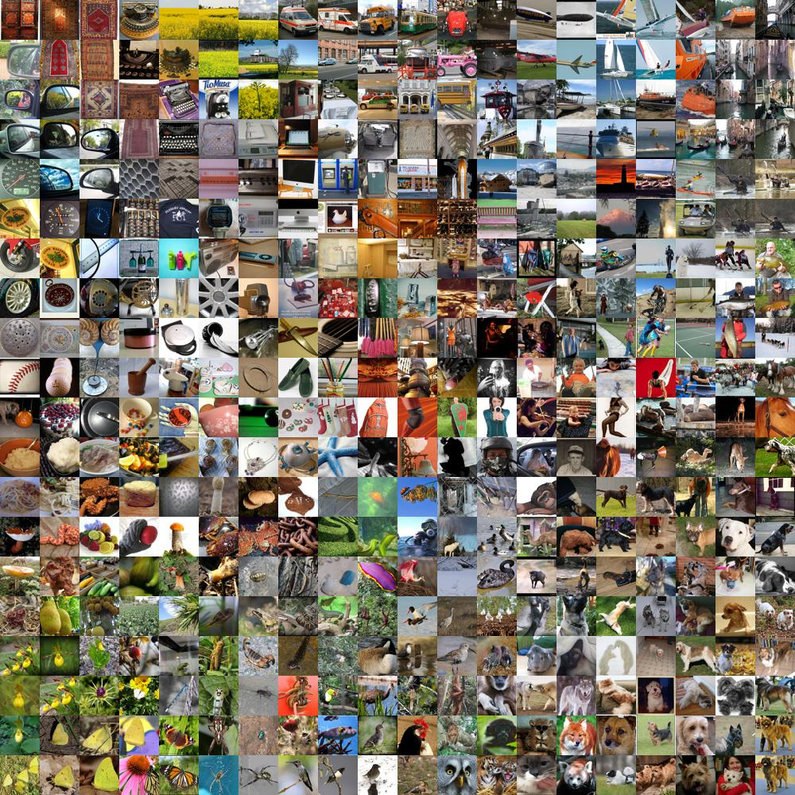
Big benchmark datasets
What it is: Huge visual database of real-world objects.
Classic subset (ImageNet-1K / ILSVRC): ~1.2 million training images, 50,000 validation images, 100,000 test images. 1,000 object categories. Wikipedia+2Hugging Face+2
Full ImageNet (a larger version sometimes called ImageNet-21K): Tens of thousands of categories and over 14 million images originally. Wikipedia
Task: Large-scale object classification (Which class is in this image?), plus localization (Where is it? bounding box).
Why it matters:
ImageNet is the reason deep learning blew up in vision in 2012: AlexNet crushed this challenge and changed the field.
Today, many pretrained CNNs (ResNet, EfficientNet, etc.) come “pretrained on ImageNet.”
ImageNet
What is in this photo?
https://www.gopichandrakesan.com/day-27-imagenet-dataset-largest-visual-database/

Slide 8
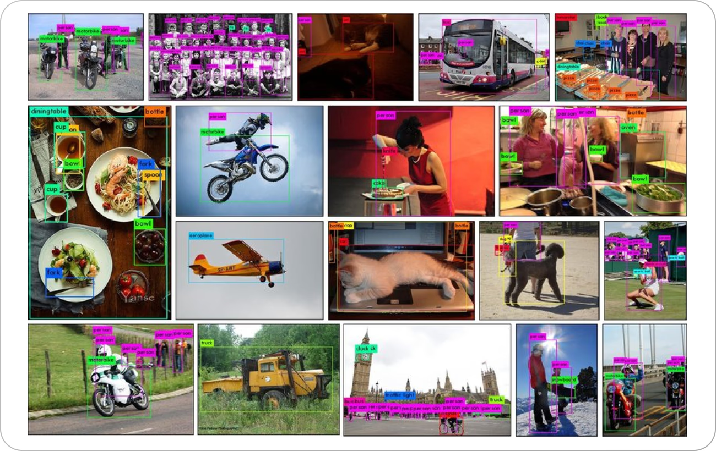
Big benchmark datasets
What it is: Everyday scenes with multiple objects.
Size: Roughly 330,000 images with dense annotations. 80 object categories. cocodataset.org+2docs.ultralytics.com+2
Tasks:
Object detection: draw a box around each object.
Instance segmentation: outline each object’s exact shape.
Keypoints: find where body joints are.
Image captioning: describe the scene in natural language.
Why it matters:
It’s “objects in context,” not just a single centered object. So it’s much closer to the real world.
Used to benchmark detection models like Faster R-CNN, YOLO, etc.
COCO
Where are all the things, and what are they doing?
https://www.v7labs.com/blog/coco-dataset-guide

Slide 9
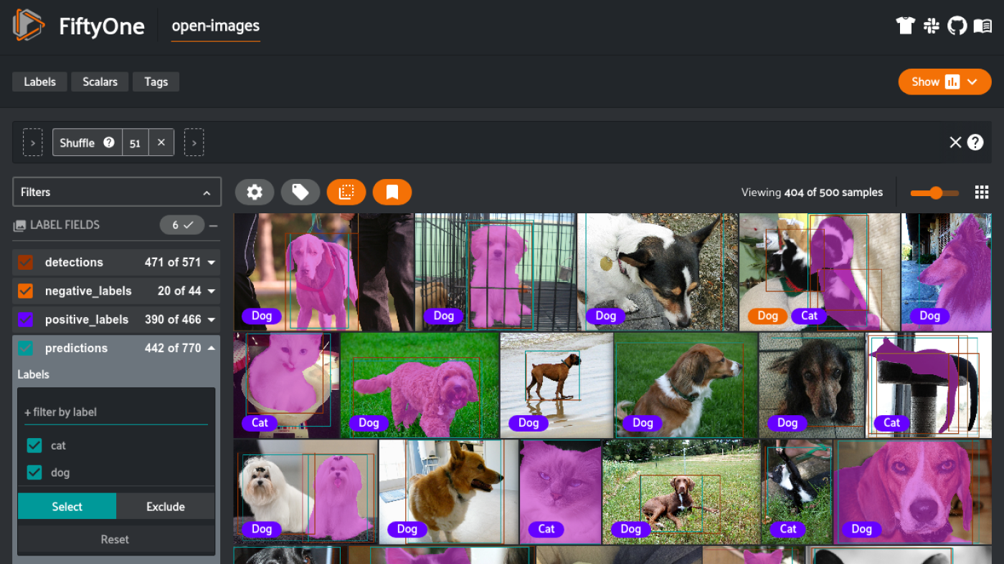
Very large / modern / multi-label datasets
Open Images (by Google)
Scale: Millions of real photos with tons of different labels.
Annotations:
Image-level labels (what’s present)
Bounding boxes for objects
Instance segmentation masks
Relationships between objects (“man holding cup”)
Human-written localized narratives describing regions
Open Images is what you use when you want to train models that need to understand complicated real scenes at internet scale
https://medium.com/voxel51/exploring-googles-open-images-v7-a6218d0098cb

Slide 10
How do I get these datasets ?
(train_images, train_labels), (test_images, test_labels) = keras.datasets.cifar10.load_data()

Slide 11
Custom image data (you collect and label it)
Workflow:
Collect images yourself.
Label them.
For image classification
one label for the whole image
For object detection
draw bounding boxes around each object
For segmentation
label pixels
Tools for labeling include VGG Image Annotator, ImageJ with plugins, COCO Annotator.

Slide 12
Custom image data
Then you preprocess:
Resize images to a consistent size so they all match (for example, make them all 32×32).
Augment images (random flips, rotations, brightness changes) to make the model more robust.
Normalize pixel values so they’re on a stable numeric range (for example scale 0 to 255 down to 0 to 1).
Encode labels as numbers the model can use.
Split into train / validation / test sets.
Key idea: Images are just numbers. Each image is really an array (height × width × channels). Each pixel is one little square of color.

Slide 13
How much data do we need ?
Deep learning models are data-hungry.
• From-scratch training: thousands of labeled images per class
• With transfer learning: much less data required
Data quality and diversity are crucial.

